Slide 1

AMSAT
FOX+
ENGINEERING
FOX+
Project Status
Review
November 6, 2024
Notes:
FOR OFFICAL USE ONLY

Slide 2
FOX-Plus Project Status Review
FOX+
Purpose and Overview
II. COTS Components (ISISPACE)
a. Frame / Structure
b. Antenna System (AntS)
c. Electrical Power System (EPS)
d. Solar Panels
III. AMSAT Linear Transponder Module (LTM)
a. Fox-Plus Internal Housekeeping Unit (IHU)
b. Improved Command Receiver (ICR)
c. RXTX
IV. Software
V. Summary
4

Slide 3
FOX-Plus Project Status Review
FOX+
I. Purpose of this PSR
The purpose of this PSR is to determine the readiness of the Fox-Plus project for Preliminary Design Review.
AMSAT PDR has 3 Main Purposes:
1. Evaluation of initial state of the design against the proposed system/subsystem requirements (“desirements”)
2. Provide a common “status state vector” for all developers, operators, et al, specifically:
- Cross team communication
- Opportunity for design teams to explain their design approach and present the status of each subsystem
- Identify major problem areas/risks/obstacles and planned migration actions under the EM phase
3. Provide a record of design decisions and the motivating reasons
4

Slide 4
FOX-Plus Project Status Review
FOX+
What this PSR is Not
It is not a technical design presentation
This PSR does not contain design specifications such as power requirements /analysis, interface specifications
It is focused on the development status of the various components that make up the Fox-Plus-A satellite
4

Slide 5
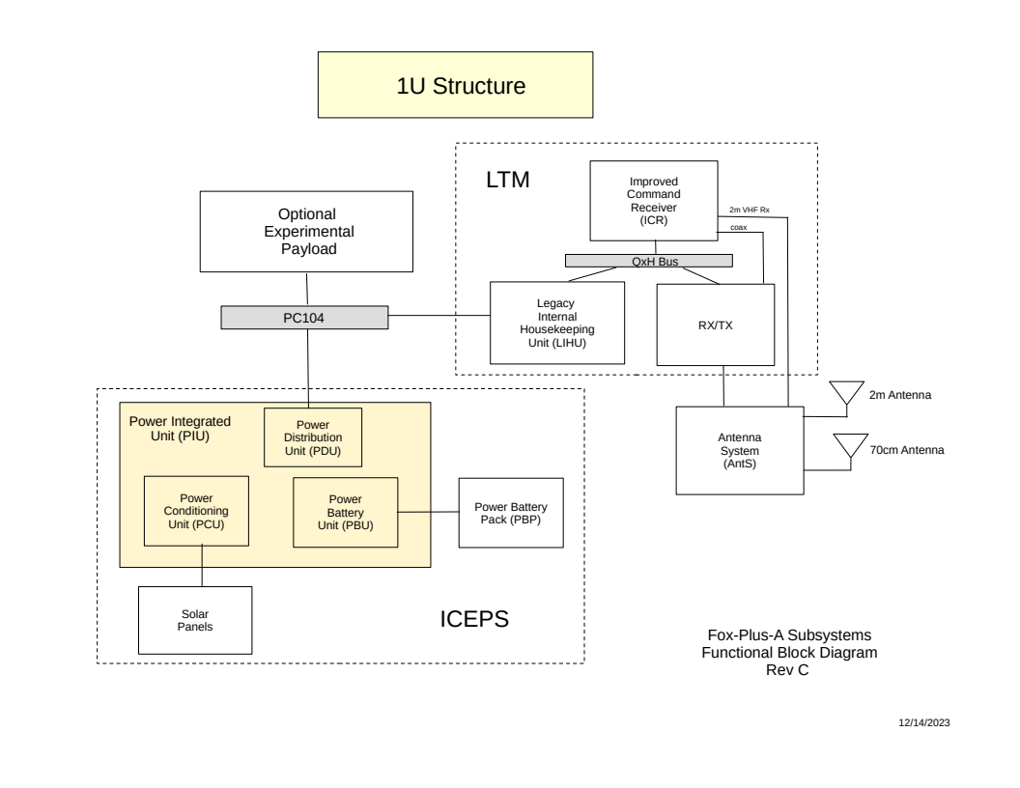
FOX-Plus Project Status Review
FOX+
Fox-Plus System Overview
4

Slide 6
FOX-Plus Project Status Review
FOX+
II. Commercial Off-the-Shelf (COTS) Components:
ISISPACE (ISISPACE.nl)
- Frame
- EPS
- Solar Panels
- Antenna System
4

Slide 7
FOX-Plus Project Status Review
FOX+
IIa. ISISPACE Frame
Current Status: we have quantity two; Andrew has one frame, the other is in the storage shed in Texas. Andrew also has building jigs used to support the structure during component integration
4

Slide 8
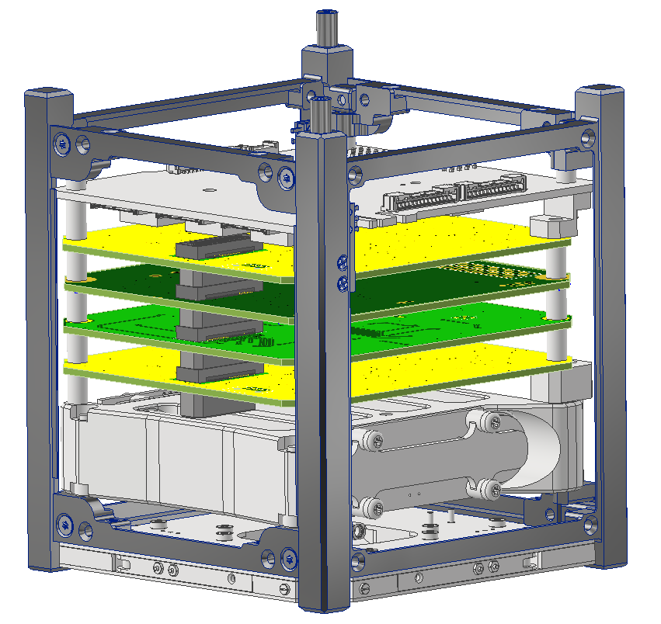
FOX-Plus Project Status Review - Structure
FOX+
ISISpace 1U Frame
ISISpace Power Integration Unit (PIU)
Adapters
TBD Payload
LIHU
ICR
RXTX
Adapters
ISISpace Power Battery Pack (PBP)
ISISpace AntS
SA’s not shown...obviously
4

Slide 9
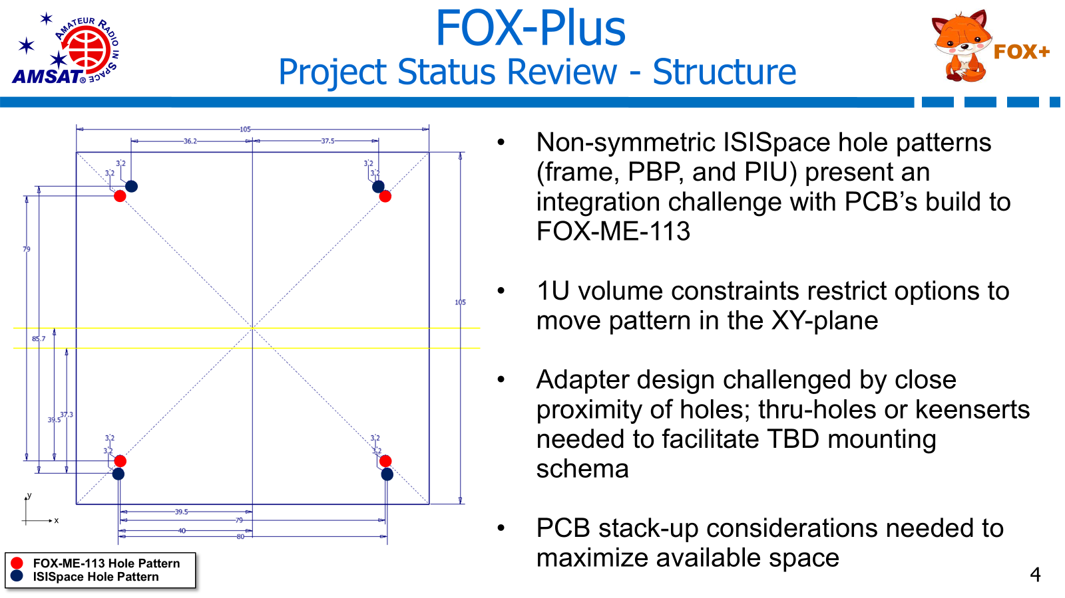

Slide 10
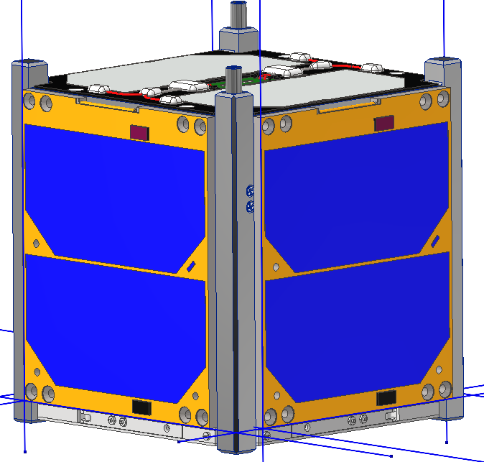
FOX-Plus Project Status Review - Structure
FOX+
Things To Do (on the road to CDR):
Clean up ISISpace-to-FOX-ME-113 adapter concept
Determine mounting schema – fasteners, threaded rods, keenserts
Perform tolerance stack up – determine tolerancing needs for new parts and potential shimming
Select hardware – material, type, finish, grade
Lay out cable paths
Develop assembly procedures – leverage Autodesk Inventor to lay out steps to put assembly together
Mature MEL / mass properties
Perform analysis – structural, thermal, etc.
Build GD&T drawings for fabricated parts
Snap a baseline in Git-Hub – review and approve design (model and/or drawings) and push to main trunk
Weird blue lines are in the provided SA models
4

Slide 11
FOX-Plus Project Status Review
FOX+
IIb. ISISPACE EPS
Current Status: this unit has not been interconnected to the Fox-Plus IHU as yet. It cannot be connected to the LIHU due to pins being used contrary to the CSKB “standard”. The I2C software interface has not been tested as it is not yet available
Issues / challenges: interconnect as shown in previous Structure slides
Next Steps: Get the F+IHU boards built so that the interface can be tested. Software will need to be developed. Board spacing adaptors need to be built.
4

Slide 12
FOX-Plus Project Status Review
FOX+
IIc. ISISPACE Solar Panels
Current Status: Zach is shipping the 10 ISISPACE Solar Panels to me. I will keep 5 and ship 5 to Andrew for EM build.
Issues / Challenges: none known at this time.
Next Steps: for me: receive panels and test with EPS. For Andrew: receive panels and test form and fit on frame
4

Slide 13
FOX-Plus Project Status Review
FOX+
IId. ISISPACE Antenna System (AntS)
Current Status: We have two AntS. I have one, Andrew has one. I have tested antenna deployment with AMCOM Over the Air (OTA) commands successfully. Interconnect cable uses expensive Omnetics connectors / cable (more in Fox+ IHU slide)
Issues / challenges: expensive connectors / cables being researched. This works as expected. Good design
Next Steps: software needs to be updated. Getting bad return status for deploy commands
4

Slide 14
FOX-Plus Project Status Review
FOX+
III. AMSAT Linear Transponder Module (LTM)
- Fox-Plus Internal Housekeeping Unit (F+IHU)
- Improved Command Receiver (ICR)
- RXTX
4

Slide 15
FOX-Plus Project Status Review
FOX+
IIIa. Fox-Plus Internal Housekeeping Unit (F+IHU)
New version of the IHU (v7) was necessary due to compatibility issues with the ISISPACE EPS, mainly PC104 signal pinouts.
Current STATUS: 3 bare PCBs have been produced and inspected. Need to get layers diagrams and BOM and verify against schematic, identify “unobtainiums” etc
Issues / Challenges: Bdale has been slow to respond to requests. We have v7 gerbers (thanks to Bill Schell), can get BOMs
Next Steps: verify board layout and get pricing for build. Need to get prototype boards built ASAP in order to test with EPS.
4

Slide 16
FOX-Plus Project Status Review
FOX+
IIIb. Improved Command Receiver (ICR)
New versions of the ICR has been produced, v2.1 and v2.2. Boards are being built
Current STATUS: v2.1 board had shields installed which were difficult to remove. Also solder bridges found on boards. – Leandra MacLennan
V2.2 boards are being built by Dave Hartrum.
Issues / Challenges: skip v2.1 and go to v2.2? Dave Hartrum is building them
Next Steps: test v2.2 boards – Dave Hartrum.
4

Slide 17
FOX-Plus Project Status Review
FOX+
IIIb. Improved Command Receiver (ICR) V2.1
Test issues with V2.1
Testing in progress
3 boards had been assembled: S/N 38, 39, 40
Shield cans were soldered in place on all boards before testing and coax pigtail installation. Difficult to remove the shields, but doable.
Successfully removed the two shield cans on S/N 38.
P1 & P2 were incorrectly installed on S/N 40. The footprints for the connectors were damaged when the connectors were removed by the assembler. This board is no longer useable in a stackup.
3.579 MHz clock not working on S/N 39
U3/U4 clock not working on S/N 38
3.3 VDC power supply looks OK on all three boards
4

Slide 18
FOX-Plus Project Status Review
FOX+
IIIb. Improved Command Receiver (ICR) V2.2
ICR design has been updated as follows:
- LNA device change from MICRF3000(now EoL) to MAX2634
- Changed TCXO powering back to earlier version when it was switched based on RX_ENABLE signal. This is a significant power consumption reduction.
- RSSI comparator device changed to a true comparator, not an op-amp
- Baseband audio filter now uses 3 op-amp stages. Response optimized.
- Component layout around SA636 device changed to optimize performance.
- Fudicials added to the PWB to facilitate Contract Manufacturer assembly.
4

Slide 19
FOX-Plus Project Status Review
FOX+
IIIb. Improved Command Receiver (ICR) V2.2
ICR v2.2 board build and test status:
- First set of boards ordered and received by Eric but then found to have a footprint error for U8 oscillator.
- The PWB design being updated now to correct U8 error and to add fiducials for CM assembly.
- Working with MITSI as our CM to get a quote for board assembly. Should have a quote in the next few days.
- Testing of electrical design changes tested as best possible on modified earlier revision boards.
- Ready to test v2.2 boards as soon as we can get them assembled through the CM.
4

Slide 20
FOX-Plus Project Status Review
FOX+
IIIc. RXTX board
New version of the RXTX board is being worked by Eric.
Current STATUS: work in progress on the RXTX
Issues / Challenges: work on the new version of the RXTX board is being delayed due to GOLF-TEE priorities
Next Steps: use last version of RXTX for the Fox-Plus LTM? Works well on ME-SAT!
4

Slide 21
FOX-Plus Project Status Review
FOX+
IV. Software
There are 3 separate software modules:
Flight software – firmware on the IHU
AMCOM – Over-the-Air (OTA) test command software
Fox Telecom – telemetry
4

Slide 22
FOX-Plus Project Status Review
FOX+
IVa. Flight Software
Firmware on the F+IHU
Current Status: Will Brozovic and Cliff Jenkins have each setup development tools and have attended training sessions with Burns
Will has IDE Linux machine both working. He can compile and upload the flight software to the IHU he has. Computer runs Ubuntu Linux and he interfaces to the IHU with an STLink.
Cliff has worked on the repositories and has them ready for Fox+ development. He has IDE and Linux machine set up, can compile and upload flight software to the IHU he has onhand. He is currently testing the STLink.
Summary: both developers are set up and ready to begin Fox+ flight software development. First steps may be to trim out unneeded GOLF code.
Issues / Challenges: gaining experience with the code.
4

Slide 23
FOX-Plus Project Status Review
FOX+
IVb. AMCOM Over-The-Air (OTA) Software
Software application that runs on MS Windows
Current Status: this software will not need significant changes. A text file defines each satellite including commands and codes available for it. Heimir can make changes for F+ IHU if needed
Issues / Challenges: none at this time
Next Steps: make changes for the Fox+ IHU.
4

Slide 24
FOX-Plus Project Status Review
FOX+
IVc. Fox Telecom – Ground Station Software
Ground Station Software
Current Status: this software will not need significant changes and can be done in the future
Issues / Challenges: none at this time
Next Steps: make changes for the Fox+ LTM testing
4

Slide 25
FOX-Plus Project Status Review
FOX+
V. Summary
Biggest Challenges / Issues:
Currently the biggest issues are:
Integrate AMSAT boards into the ISISPACE frame and interconnect the boards such that we can put payload board(s) into the stack as detailed
Build and test the v7 IHU board for interface to the ISISPACE EPS. This is unproven and may require modifications
In order to have a Preliminary Design Review Dec 5th, we need (Discussion)?:
A proven solution to board interconnect (issue #1)
IHU v7 board into test (issue #2)?
What else?
4

